Slide 1
TEAM SPORTS INTRO
PHYSICAL EDUCATION

Slide 2
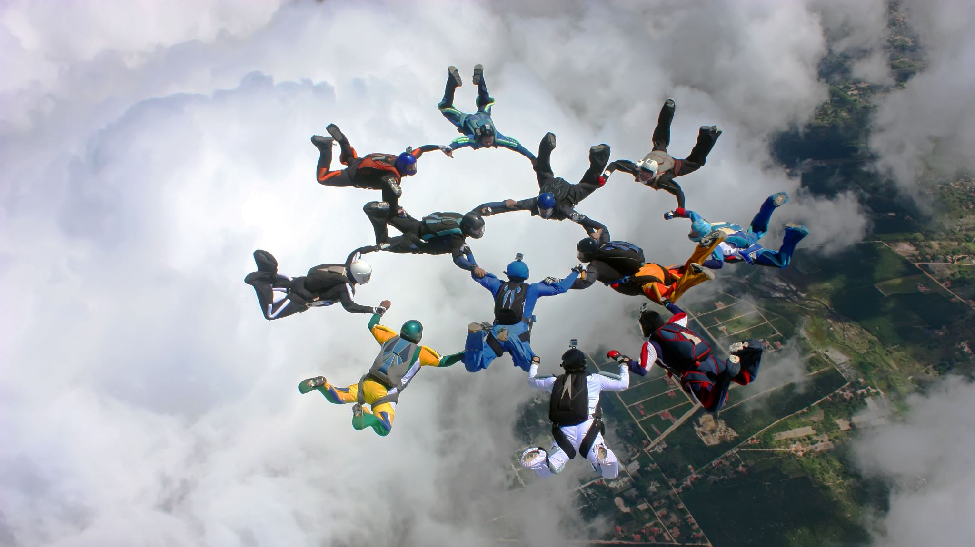
Teamwork

Slide 3
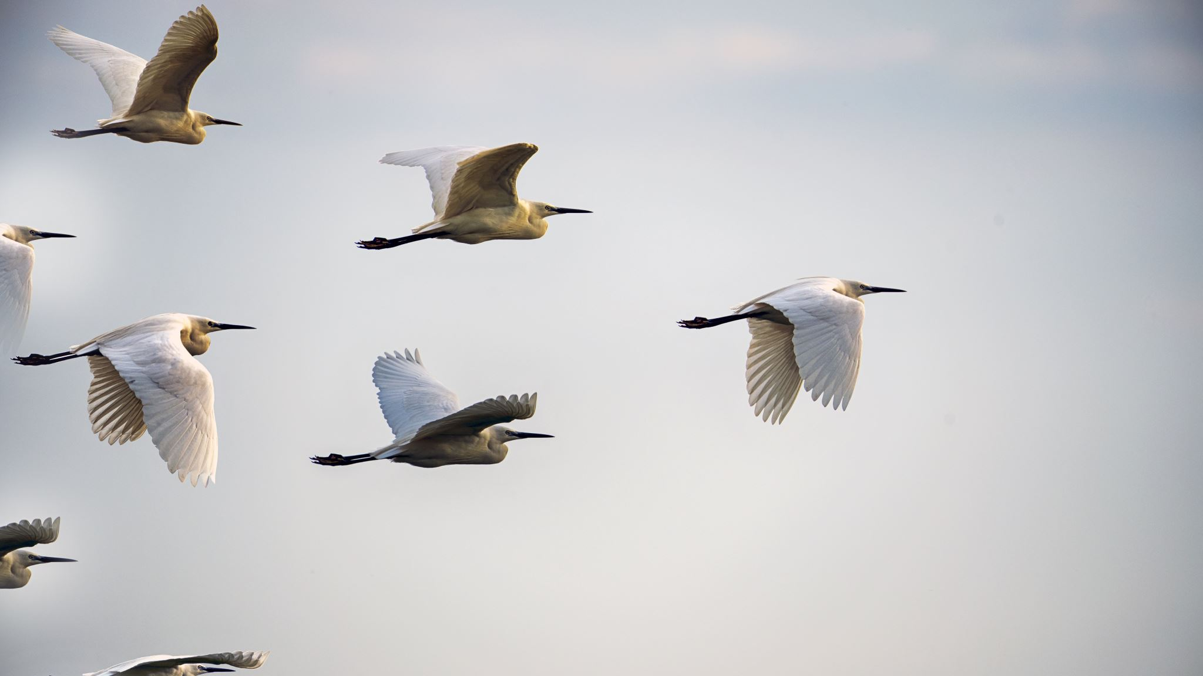
Accountability

Slide 4
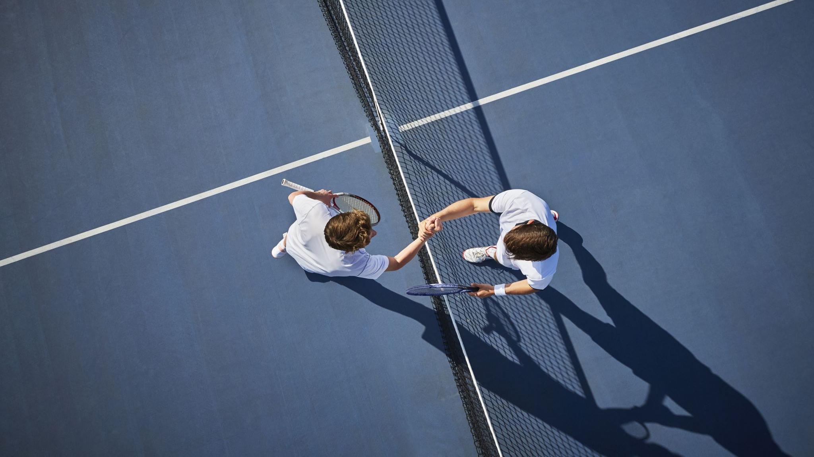
Sportsmanship

Slide 5
Offense

Slide 6
Defense

Slide 7

Basketball

Slide 8

Football

Slide 9

Volleyball

